Slide 1

Intelligent Human Face Deepfake Detection System with Explainable AI
Student Name & Roll no | Project Guide
248445100045 Pandi Surekha | Mrs. P S V D GAYATRI
Department of Computer Science
Adikavi Nannaya University MSN Campus, Kakinada

Slide 2
Outline Content
Abstract
Problem Definition/Statement
Scope of the Project
Motivation behind the Problem Selection
Existing System and Drawbacks
Design of Proposed Solution
System Requirements
Functional Requirements&Non Functional Requirements
System Methodology
Design of Proposed System
UML Diagrams
Code Snippets
Output Screenshots
Conclusion

Slide 3
Abstract
The rapid growth of deepfake technology has made it difficult to verify the authenticity of digital videos.
This project presents an Intelligent Human Face Deepfake Detection System using deep learning for accurate classification.
The system uses InceptionV3 to extract spatial and texture-based facial features from video frames.
A sequence model analyzes temporal patterns across frames to detect deepfake manipulations.
The system performs binary classification (Real or Fake) and provides a confidence score.
To overcome the black-box nature of deep learning, Explainable AI techniques are used.
Gradient-based methods and Grad-CAM highlight important frames and manipulated facial regions.
The explainability module visually highlights manipulated facial regions, improving transparency and user trust.

Slide 4
Problem Definition / Statement
The increasing use of deepfake technology enables the creation of highly realistic fake images and videos that are difficult to detect by humans.
Existing deepfake detection systems mainly focus on accuracy but operate as black-box models, providing no explanation for their decisions.
Lack of transparency reduces user trust and makes it hard to verify or justify detection results in sensitive applications.
Manual verification of digital media is time-consuming, error-prone, and impractical for large-scale platforms.
Current systems fail to clearly identify which regions or features of media are manipulated.
There is a need for an intelligent, accurate, and explainable deepfake detection system that not only detects fake content but also explains the reasoning behind its predictions.

Slide 5
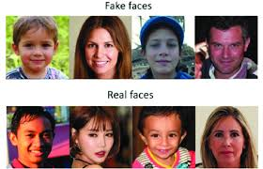
Scope of the Project
Detect DeepFake images and videos using advanced deep learning models.
Use state-of-the-art architectures like InceptionV3 and sequence model.
Integrate Explainable AI (XAI) methods such as Grad-CAM and Gradient-based methods for visual explanations.
Train and evaluate models using benchmark datasets (FaceForensics++, DFDC, Celeb-DF).
Provide a user-friendly web interface for uploading media and viewing results.
Display prediction, confidence score, and explanation heatmap.
Optimize the model for fast, real-time inference.
Deliver a deployable prototype useful for media verification and cybersecurity.

Slide 6
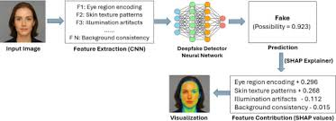
Motivation behind the problem selection
Deepfake technology has become a major threat in today’s digital world, where anyone can create realistic fake videos or images using AI. These Deepfakes can spread misinformation, damage reputations, influence politics, and be used for cybercrimes. Most existing detection systems work like “black boxes,” giving results without explaining why something is fake. This reduces trust and makes verification difficult.
To solve this, we chose this project to build a system that not only detects Deepfakes but also explains how and why it made the decision, making the results more transparent and trustworthy. With the rise of social media manipulation and AI-generated content, there is a strong need for an explainable, accurate Deepfake detection system that common people, investigators, and organizations can rely on.

Slide 7
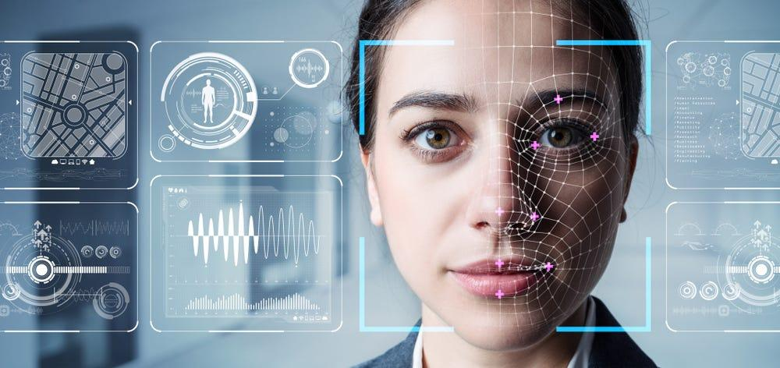
Existing system and Draw backs
Existing System
Uses CNN-based models (VGG, ResNet, MobileNet) and some advanced models (XceptionNet, EfficientNet) for DeepFake detection.
Detects pixel inconsistencies, facial artifacts, and GAN-generated patterns.
Some forensic methods check lighting, eye blinking, or head movement.
Social media platforms use internal DeepFake detectors.
Drawbacks
No Explainability → Models act as black boxes; no visual explanation of manipulated areas.
Poor Generalization → Accuracy drops on unseen or new DeepFake techniques.
Fails on Real-World Videos (low-quality, compressed, noisy).
Not User-Friendly → No simple interface for common users.
Slow or Non-Real-Time Detection requiring high computing power.
Limited Deployment → Hard to integrate into real applications.

Slide 8
Design of Proposed Solution
User uploads image or video through a web interface
Input media is preprocessed (frame extraction, resizing, normalization) and detecting faces using OpenCV.
Deep learning models (Inceptionv3, Sequence model) extract 2048-dimensional facial features
These features are given to a sequence model to analyze temporal inconsistencies
Models are trained on, FaceForensics++, Celeb-DF, DFDC datasets
System classifies media as Real or Fake with a confidence score
Explainable AI (Grad-CAM) highlights manipulated facial regions
Results displayed with prediction, confidence, and heatmap explanation
Optimized for real-time detection and deployment
Advantages
High Accuracy using advanced deep learning models
Explainable Decisions using XAI instead of black-box predictions
Improved User Trust through visual explanations
Robust Detection against modern and unseen Deepfake techniques
Real-Time Performance suitable for practical applications
User-Friendly Interface for non-technical users.

Slide 9
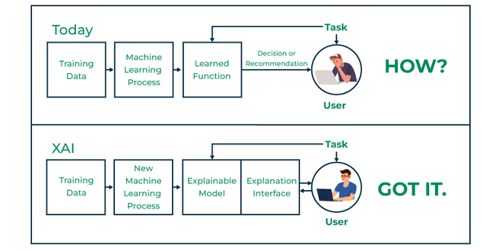
System Requirements
Hardware Requirements
Processor: Intel Core i5 / AMD Ryzen 5 or higher
RAM: 8 GB minimum (16 GB recommended)
Storage: 256 GB SSD or higher
Graphics: Integrated GPU (Dedicated GPU optional)
Display: Minimum 1366 × 768 resolution
Input Devices: Keyboard and Mouse
Software Requirements
Operating System: Windows / Linux / macOS
Programming Language: Python 3.x
Development Environment: Jupyter Notebook / VS Code / PyCharm
Dataset Sources: ADS-B / Radar flight datasets (CSV format)
Diagram Tools: PlantUML / Mermaid JS
Presentation Tool: Microsoft PowerPoint / Google Slides

Slide 10
Functional Requirements
The system shall allow users to upload videos for deepfake analysis.
The system shall preprocess input media (frame extraction, resizing, normalization).
The system shall detect deepfakes using trained deep learning models.
The system shall classify media as Real or Fake.
The system shall generate a confidence score for each prediction.
The system shall apply Explainable AI techniques (Grad-CAM, Gradient-based methods) to provide explanations.
The system shall highlight manipulated facial regions in the output.
The system shall display results visually through heatmaps and labels.
The system shall support real-time inference for quick analysis.
The system shall allow administrators to update or retrain models when needed

Slide 11
Non Functional Requirements
Accuracy: The system should achieve high detection accuracy on benchmark datasets.
Performance: The system should provide results with low latency suitable for real-time use.
Scalability: The system should handle multiple users simultaneously without performance degradation.
Usability: The interface should be simple and intuitive for non-technical users.
Explainability: The system should provide clear and interpretable explanations for each decision.
Reliability: The system should produce consistent results for repeated inputs.
Security: Uploaded media should be securely processed and not stored without permission.

Slide 12
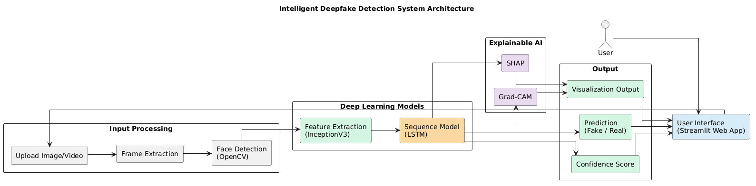
System Methodology

Slide 13
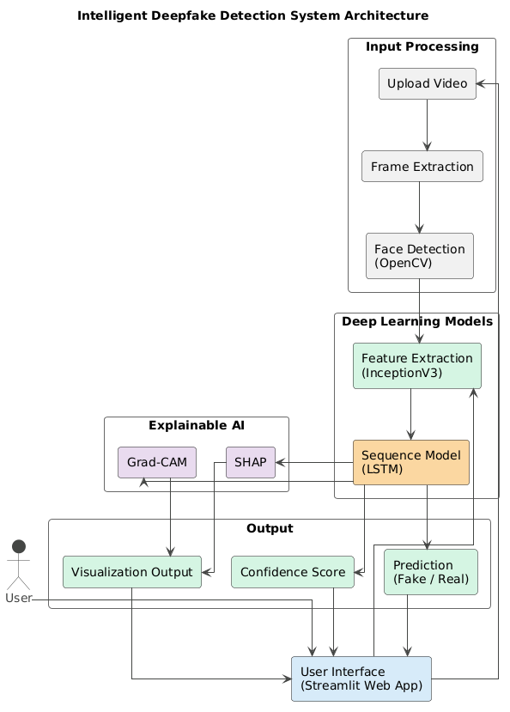
Design of Proposed System

Slide 14
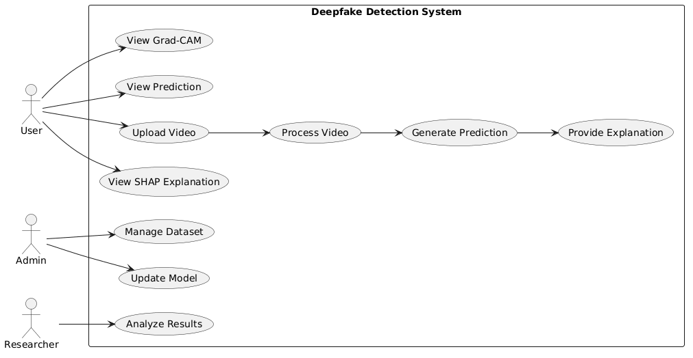
UML Diagrams
Use Case Diagram
The diagram represents how different users interact with Deepfake Detection System.

Slide 15
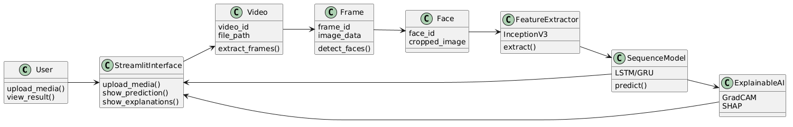
UML Diagrams
Class Diagram
It represents the internal structure of deepfake detection system.

Slide 16
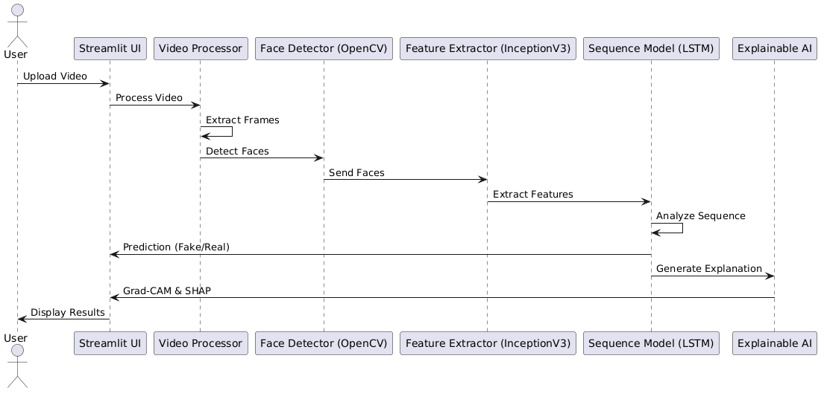
UML Diagrams
SEQUENCE Diagram
It shows who interacts with whom, In what order (time flow top → bottom)

Slide 17
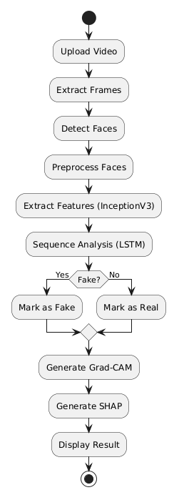
UML Diagrams
Activity Diagram
It shows:
Process flow (start → end)
Decision making
Sequence of operations

Slide 18
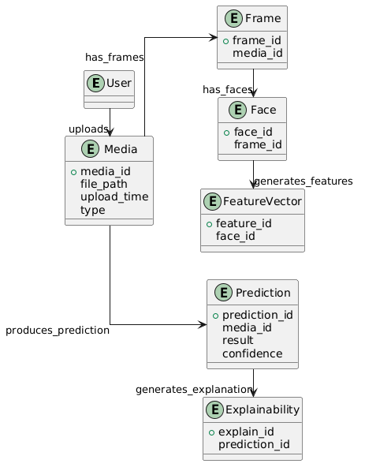
UML Diagrams
ER Diagram
This diagram shows how data
flows and is stored in system.

Slide 19
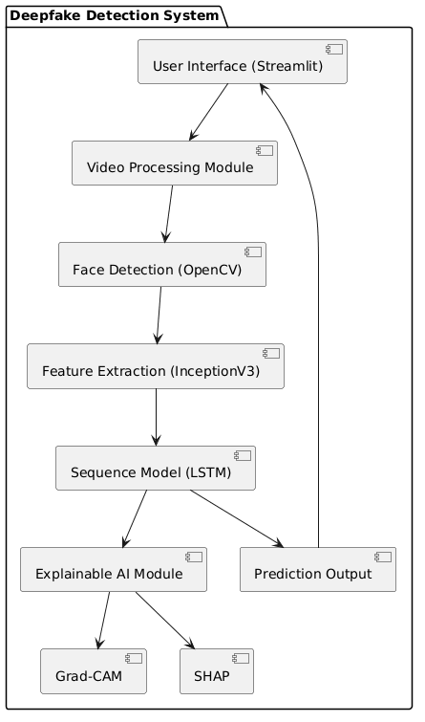
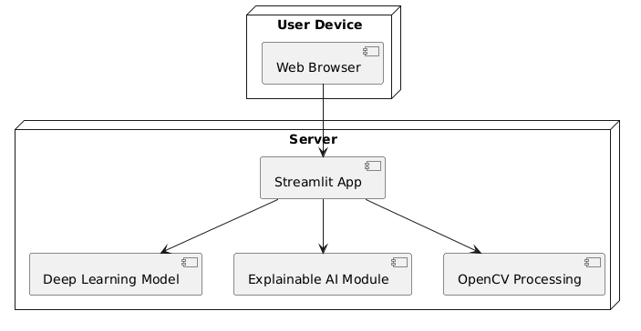
UML Diagrams
Deployment Diagram
Component Diagram

Slide 20
Implementation / Code Overview
The system is implemented using Python, TensorFlow, OpenCV, and Streamlit.
The input video is processed using OpenCV to extract frames.
Face detection is applied to focus on facial regions.
InceptionV3 is used to extract 2048-dimensional feature vectors from each frame.
A sequence model analyzes temporal patterns across frames.
The system predicts whether the video is Real or Fake.
Explainability is achieved using Gradient-based methods and Grad-CAM.

Slide 21
Code Snippets
1. Video Processing
frames = load_video(video_file)
#Face Detection using OpenCV
frame = crop_face_center(frame)
#Frame Selection from Video
skip_frames_window = max(int(total_frames / SEQ_LENGTH), 1)
This code loads the video and extracts frames for processing.
Detects and crops the face region, because deepfake manipulation mainly occurs on faces.
Ensures we select evenly spaced frames from the video instead of processing all frames, which improves efficiency.

Slide 22
Code Snippets
2. Feature Extraction
frame_features, frame_mask = prepare_single_video(frames)
Here, InceptionV3 extracts 2048 features from each frame, which represent facial patterns.
#Feature Vector Creation
frame_features = np.zeros((1, SEQ_LENGTH, 2048))
This creates a structure to store extracted features for all frames.
#Frame Importance Calculation
importance = tf.norm(grads[0], axis=-1)
Calculates the importance of each frame in the final decision.
The model predicts fake and real scores, and we focus on the fake probability; gradients are computed to measure how much each feature affects this prediction, since each frame has 2048 feature values, we combine them into a single importance value per frame using the norm (magnitude) of gradients, then normalize the values between 0 and 1 for easy comparison, where frames with higher gradients have more influence on the prediction and are considered more important, while frames with lower gradients are less important.

Slide 23
Code Snippets
3. Prediction
probabilities = sequence_model.predict(
[frame_features, frame_mask], verbose=0
)[0]
fake_probability = probabilities[0] * 100
The sequence model analyzes the features and predicts whether the video is fake or real.
[0] is used to extract the prediction for the input video.
probabilities[0] represents the Fake class probability.

Slide 24
Code Snippets
4. Explainability
importance, shap_values, gradcam_results = explain_prediction(
frames, frame_features, frame_mask
)
#Frame Importance Calculation
importance = tf.norm(grads[0], axis=-1).numpy()
if importance.max() > 0:
importance = importance / importance.max()
#Grad-CAM Heatmap
heatmap = tf.reduce_sum(pooled_grads * conv_out, axis=-1)
heatmap = tf.nn.relu(heatmap)
heatmap /= tf.reduce_max(heatmap) + 1e-8
The explain_prediction() function is used to generate explainability results.
It returns frame importance, SHAP-like values, and Grad-CAM visualizations.
🔹 Frame Importance Calculation
Gradients are computed to measure how features influence the prediction.
Each frame contains 2048 feature values.
tf.norm() is used to combine these into a single importance score per frame.
Higher value → frame has more impact on prediction.
Values are normalized between 0 and 1 for easy comparison.
🔹 Grad-CAM Heatmap
Feature maps are weighted using gradient importance (pooled_grads).
reduce_sum() combines all channels into a 2D heatmap.
ReLU removes negative values and keeps important regions.
Heatmap is normalized for visualization.

Slide 25
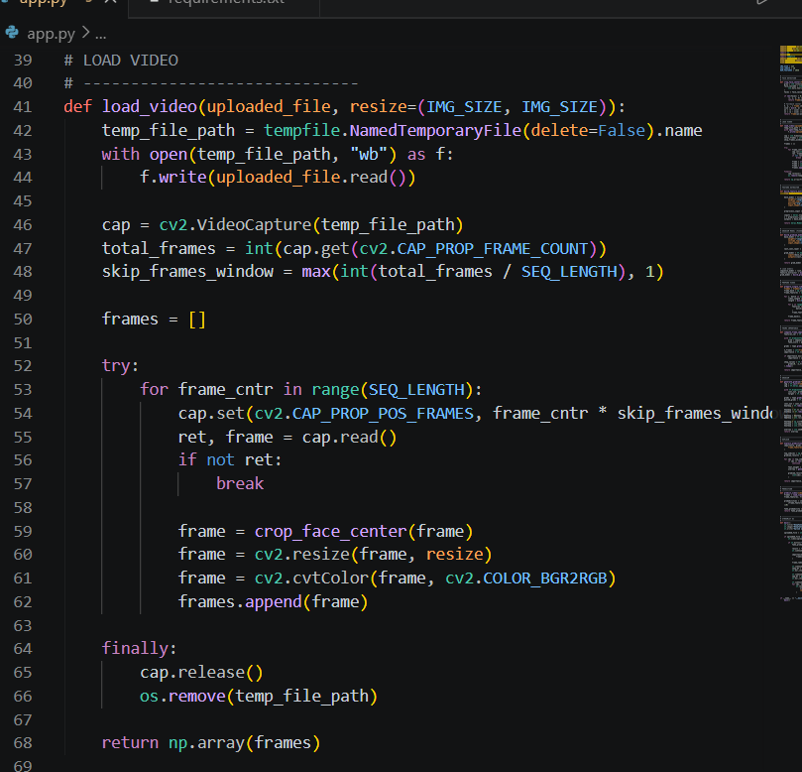
Code Snippets
Code screenshots

Slide 26
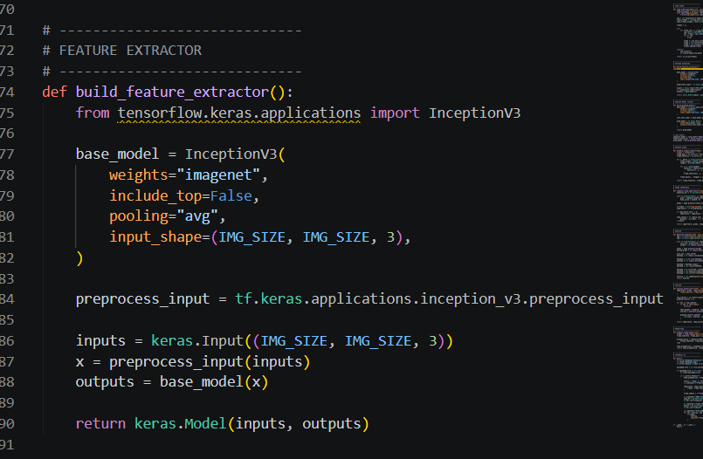
Code Snippets
Code screenshots

Slide 27
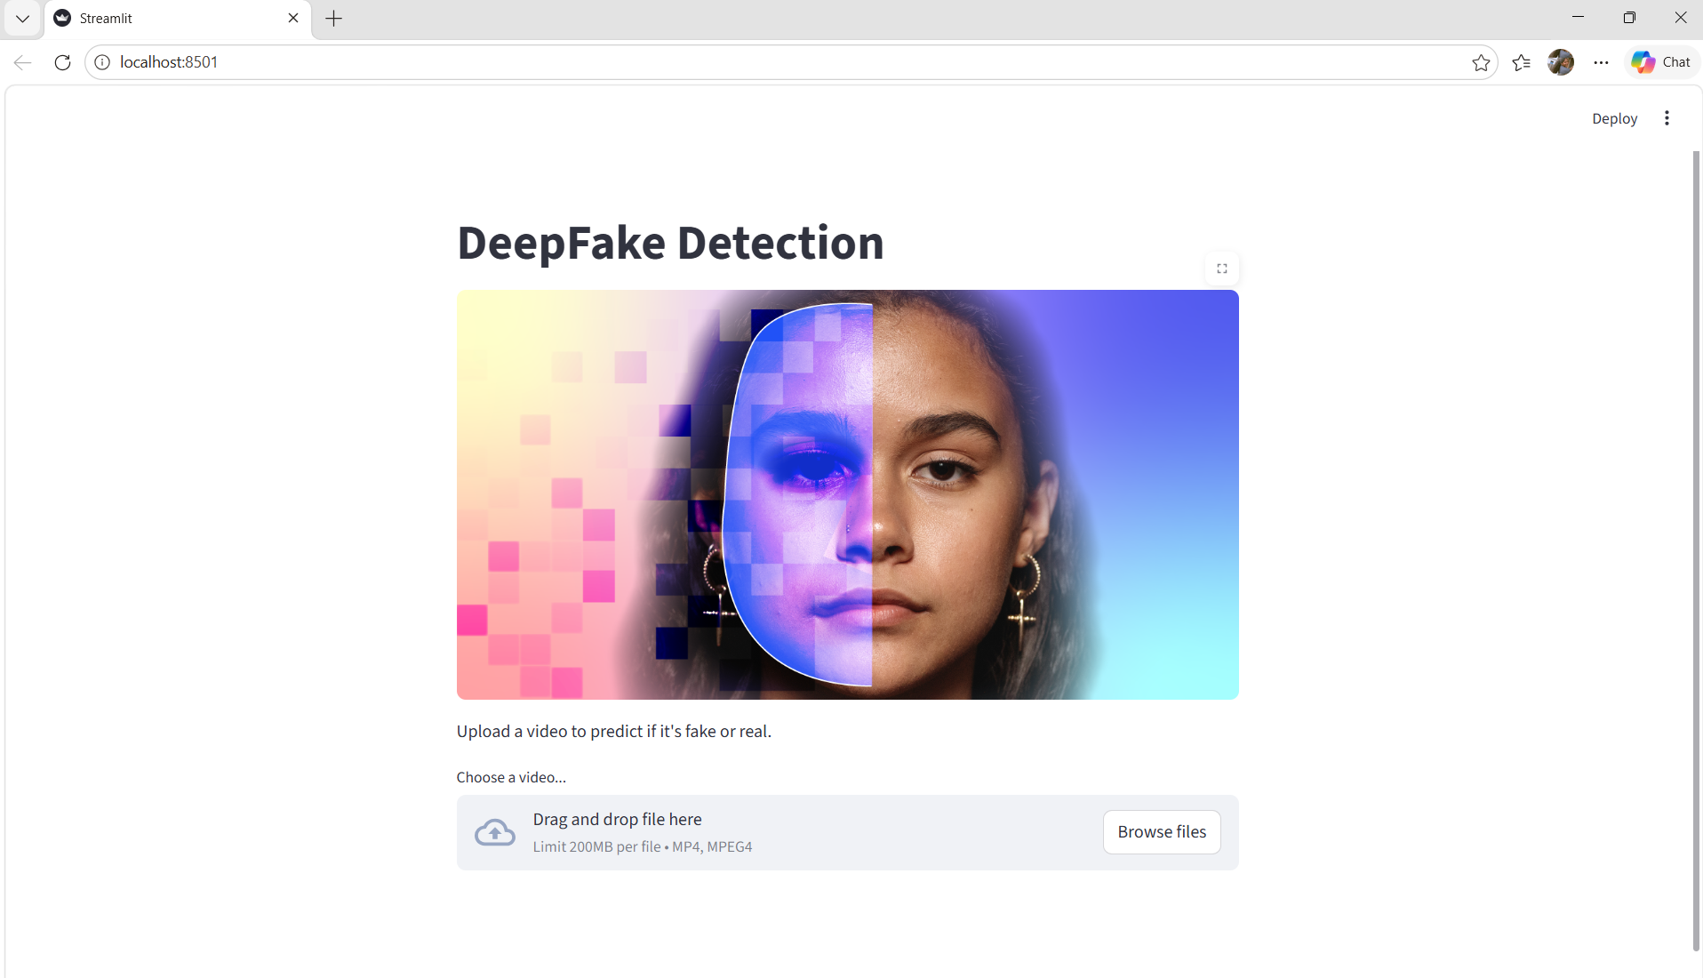
Result and Output
System Interface
The system provides a user-friendly web interface using Streamlit.
Users can upload a video file (MP4 format).
The interface allows easy interaction for deepfake detection.
Once uploaded, the video is processed for prediction.

Slide 28
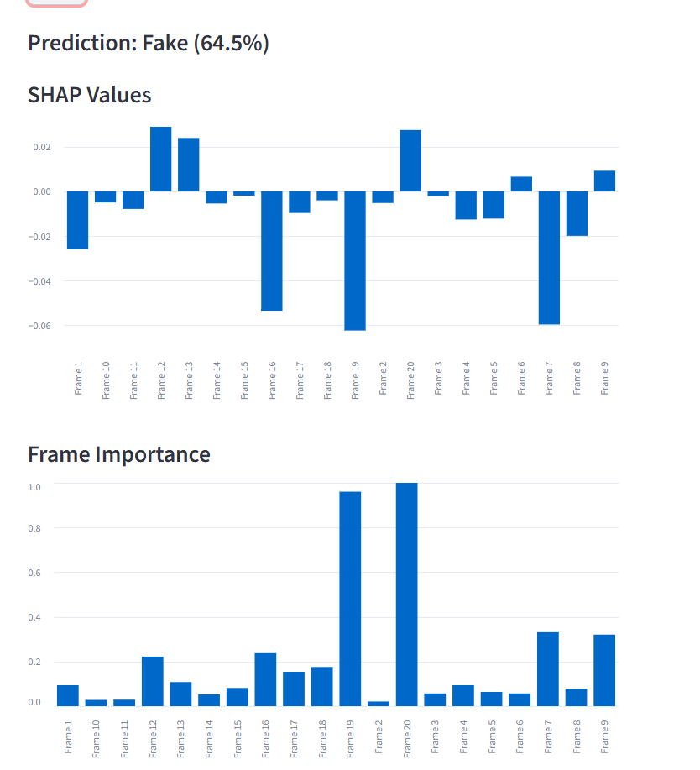
Result and Output
Prediction Result
The system predicts whether the video is Real or Fake.
It provides a confidence score (%) for the prediction.
SHAP values show contribution of each frame to the prediction.
Positive values → support fake prediction.
Negative values → support real prediction.
Helps in understanding which frames influence the result.
Frame importance indicates which frames are most influential.
Values are normalized between 0 and 1.
Higher value → more important frame.

Slide 29
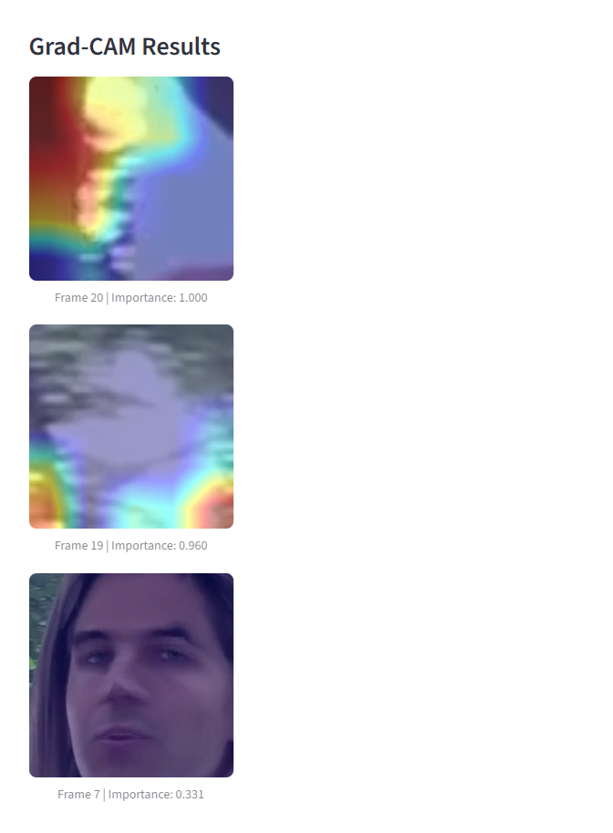
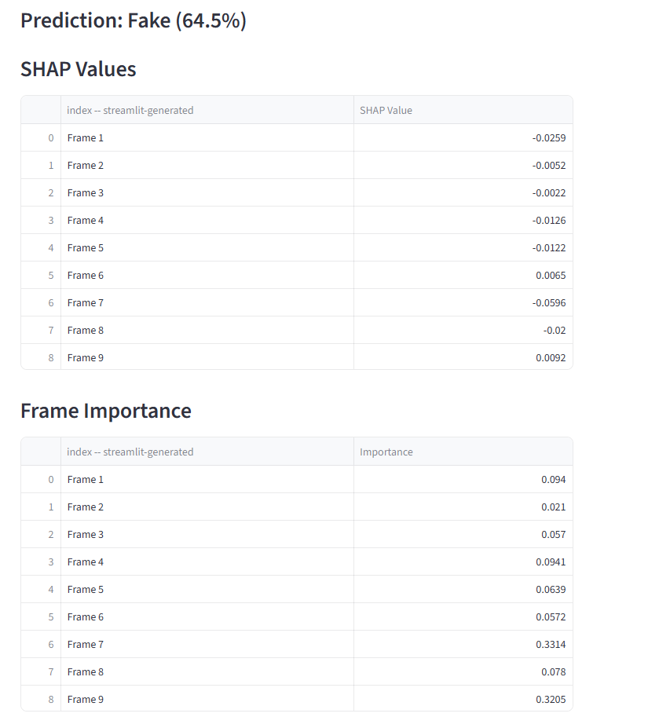
Result and Output
Grad-CAM Visualization
Grad-CAM generates heatmaps highlighting important regions.
Red/Yellow regions indicate high importance.
Shows manipulated facial areas in the video.
Improves model transparency and trust.

Slide 30
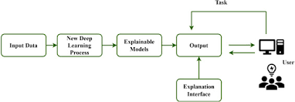
Conclusion
The Intelligent Human Face DeepFake Detection System effectively identifies manipulated images and videos using advanced deep learning models such as InceptionV3 , sequence model achieving high detection accuracy (90%–97%) on benchmark datasets like FaceForensics++ and DFDC.
By integrating Explainable AI techniques such as Grad-CAM and Gradient-based methods, the system not only predicts whether media is real or fake but also highlights the manipulated facial regions, making the model’s decision transparent and trustworthy.
This project demonstrates that combining DeepFake detection with XAI significantly improves interpretability, boosts user confidence, and enhances real-time media verification. The system provides a reliable and practical solution to combat misinformation, identity misuse, and digital fraud in today’s AI-driven digital world.

Slide 31
Thank You

